Slide 1
Table-Driven Acceptance Testing
Mario Aquino
Principal Software Engineer
Object Computing, Inc.
mario@ociweb.com

Slide 2
Session Goals…
Define the concept of Acceptance Testing (AT)
Describe its role in agile software development
Discuss the toolkits that facilitate testing
Demonstrate the writing and execution of a table-driven acceptance test

Slide 3
Test Types & Focus
Unit tests
  Exercise the public contract of single unit of code, isolated from the larger system
Integration tests
  Interact with a working system at some level
  Utilize “public” interfaces into a system
  Confirm integration between components in a working system

Slide 4
Test Types & Focus (cont.)
Acceptance Tests
  Demonstrate the implementation of customer defined system requirements
  Confirm that domain/business rules are enforced by the system as defined by the customer
  Utilize business language to represent domain concepts

Slide 5
Fostering Collaboration
The process of writing ATs has goals
  Q & A between the customer and developer
  Transfer of understanding
  Decision making
  Examples to satisfy requirements captured
  Production of the executable contract to which all are accountable
Notes:
Customers and developers pair on the authoring of an acceptance test – so the format of the test must support easy authorship by less technical folks
Questions are asked about detail, decisions are captured in the test
Examples demonstrating how the requirements might be fulfilled are an important part of the test
As the test is being written, understanding about the requirements is being transferred from the customer to the developer
The outcome of the session is an executable contract that customer and developer are accountable for

Slide 6
Objective Gauges of Progress
Features are complete when their ATs pass
Percentage completion estimates become irrelevant
Add ATs to continuous integration process & publish the results

Slide 7
Level Playing Field
ATs should be in a mutually accessible format
  Easy for customers to write, change, extend
  Easy for developers to follow and execute

Slide 8
Fit
Framework for Integrated Tests (Fit)
  http://fit.c2.com
  Originally developed by Ward Cunningham
Uses a table-based approach
  Test details appear in several varieties of tables
  Tests can be written in HTML files

Slide 9
How It Works…
Fixtures
(compiled
source files)
HTML
Test file
references
parses
executes
Fit
Test Runner
generates
HTML Test
Report

Slide 10
Framework Fixtures
fit.ColumnFixture
  Calculation-style testing
fit.RowFixture
  Equality comparison for groups of values
fit.ActionFixture
  Workflow-style testing

Slide 11
“Calculation” Testing
Business rules that depend on multiple conditions
  Varying inputs trigger different business rules
Appointments in a schedule must have
start dates/times occurring before the
end dates/times
Overlapping appointments are
not allowed for some events
Certain events are only allowed
between specific hours of the day
ColumnFixture

Slide 12
Groups of Values
Testing equality for collections of objects
Useful for checking values before/after something is done in a test
Simple or complex objects can be used
Can be domain objects or utility types
Evaluation is order independent
RowFixture

Slide 13
Sequences of Interactions
Application accessible via “device” metaphor
Devices responds to 4 keywords:
start
Begins use of fixture
enter
Adds data to system device
press
Issues command to device
check*
Reads information from device
ActionFixture
* triggers comparison

Slide 14
Using Domain Types
ATs should express concepts using business language
Domain types can be used directly
Fixtures translate strings in test tables to concrete domain types
Parsing delegates can be registered as well

Slide 15
FitLibrary
Adds new fixtures, utilities and keywords to Fit
  DoFixture – “flow” style testing
  SetUpFixture – convenient test setup
  FolderRunner – batch test execution
  setUp() & tearDown()
  SetUp & TearDown
  Keywords: reject, not (and others)
  Tests can be written in MS Excel spreadsheets

Slide 16
“Flow”-style Testing
A single fixture (DoFixture) organizes the test
Testing conditions setup
Supporting fixtures share common resources
  Parsing delegates for domain types
  References to the system under test

Slide 17
“Flow”-style Testing (cont.)
Subclasses fitlibrary.SetUpFixture
AddMovies
AddCustomers
fitlibrary.DoFixture
CheckOutMovies
MyGrandUnifyingFixture
ViewActiveRentals
fit.RowFixture
Subclasses fitlibrary.DoFixture
CalculateLateFees
fit.ColumnFixture

Slide 18
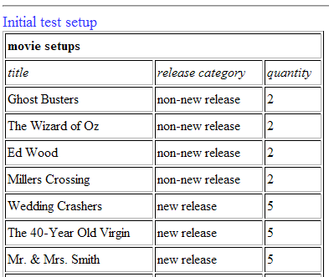
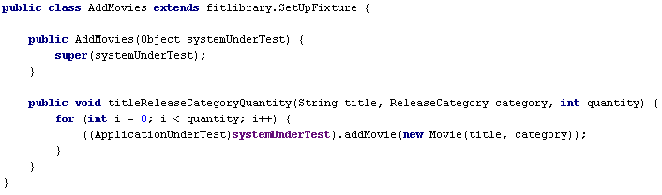
SetUpFixture

Slide 19
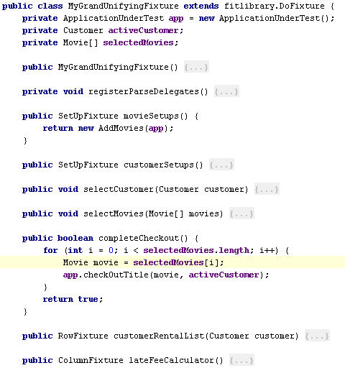
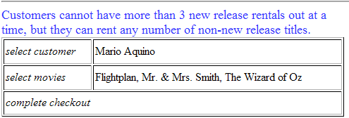
DoFixture

Slide 20
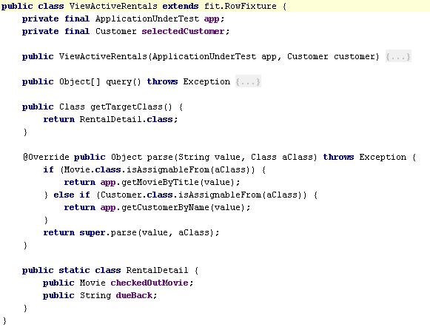
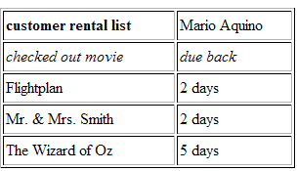
RowFixture

Slide 21
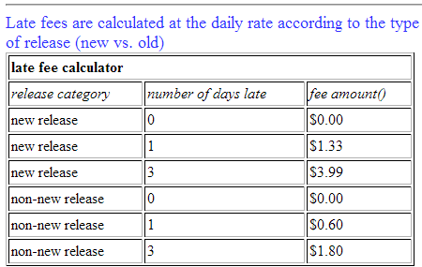
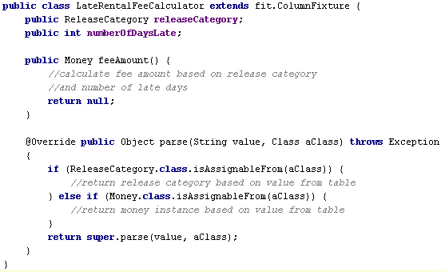
ColumnFixture

Slide 22
Batch Test Execution
fitlibrary.runner.FolderRunner
  Specify folder where tests are located
  Specify output folder
Prints a “pretty” report

Slide 23
Keywords
Fit supplies the error keyword
  Use when an exception is expected (only in ColumnFixture and ActionFixture)
FitLibrary adds several more for DoFixture
  reject & not
    Behave identically
    Cause cell evaluation to be reversed
  ensure
    Behaves the opposite of reject & not

Slide 24
The big demo…

Slide 25
Patterns and Practices
Testing the system via API
  True domain objects interaction
  Unit-style testing of the whole system
Testing the system via UI
  Test how the real users would
  Need UI driver

Slide 26
But What About???
FitNesse
  Fit/FitLibrary testing via a wiki-server
  Adds suites similar to JUnit tests suites
  Other features
    Variable substitution / Security / SetUp & TearDown
Debugging
  FitLibrary steals System.out & System.error ☹
  Use log file output (log4j)
  Launch tests with JPDA active

Slide 27
Questions???

Slide 28
References
Fit Website: http://fit.c2.com
FitLibrary: http://fitlibrary.sourceforge.net/
FitNesse: http://fitnesse.org
Fit article:
  http://www.ociweb.com/jnb/jnbDec2005.html

